Slide 1

Zeal College of Engineering & Research, Pune Department of Information Technology
Seminar Presentation on
“ Mobile Operating Systems: A Comparison of Android and iOS ”
Presented By
Jagdish Butte
Guide
Prof. Anuradha Thorat

Slide 2
Contents
Introduction
Literature Survey
Motivation and Objectives
Problem Statement
Proposed Work
Mathematical Model
Conclusion
Future Scope
References

Slide 3
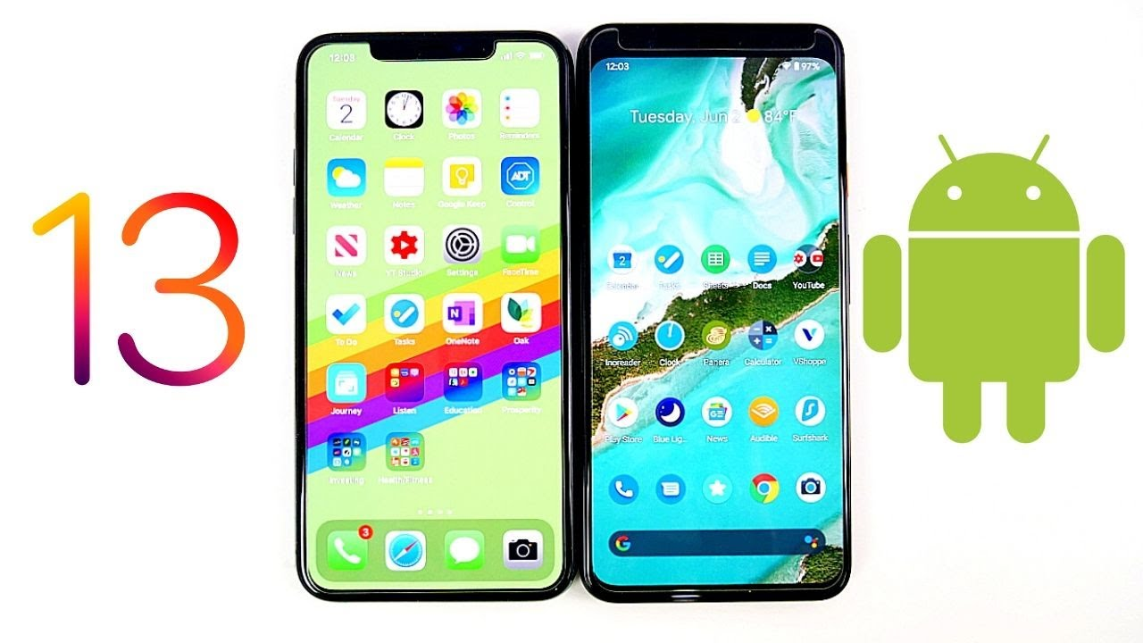

Slide 4
Introduction
Mobile operating systems are integral to modern technology interactions.
iOS and Android OS are dominant players, influencing user experiences worldwide.
This presentation examines key aspects that guide user preferences and development choices.
Explore ecosystem integration, security measures, app diversity, customization, and development challenges.
Gain insights into the strengths and weaknesses that define iOS and Android.
Empower yourself to make informed decisions tailored to your technological needs.

Slide 5
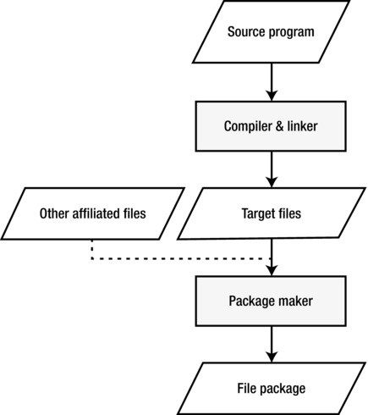
Android App Developement -

Slide 6
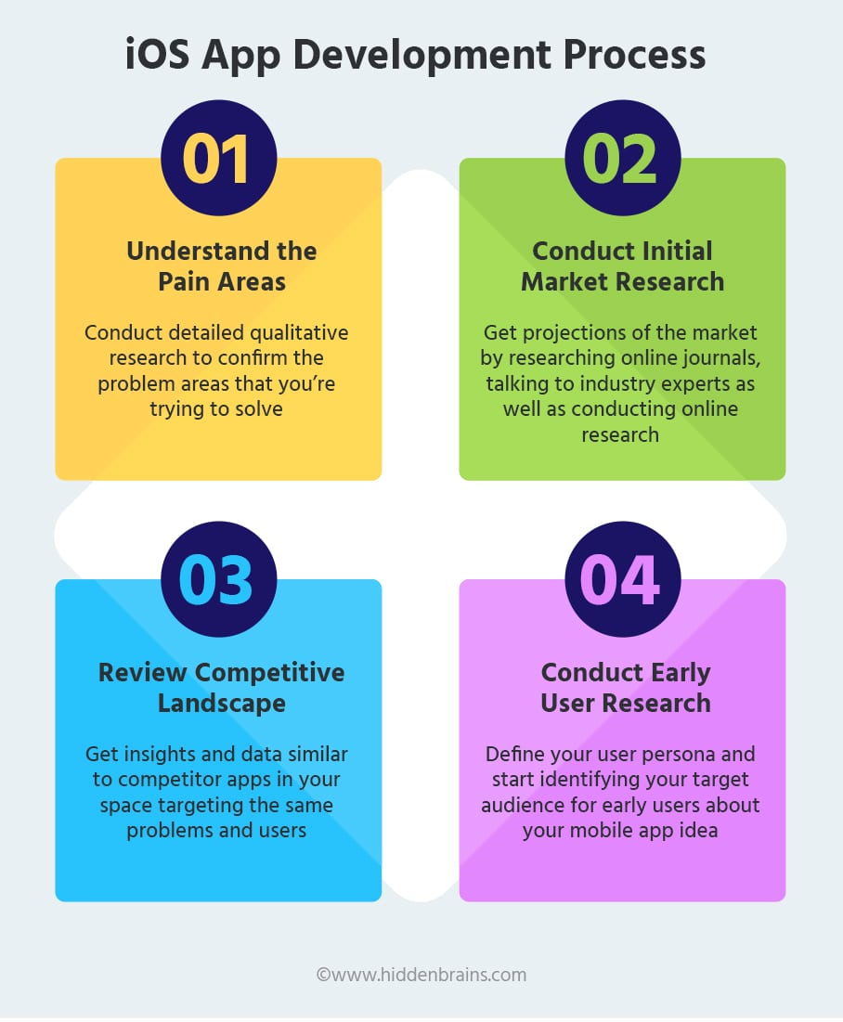

Slide 7
Literature Review
Publisher | Author | Year | Name of the paper | objective | Methodology | Limitation
Frontiers | Weifeng Hu, Tianyun Hao, Yue Hu, Hui Chen, Yi Zhou and Wantong Yin | 2023 | Research on the brand image of iOS and Android smart phone operating systems based on mixed methods | 1. To analyze the differences in system functions, interaction behaviors and user experience between iOS and Android smart phone operating system, and then study the differences in their brand images, so as to provide theory and research method for shaping corporate brand images from the perspective of product interaction design. | information visualization methods | 1.All claims expressed in this article are solely those of the authors and do not necessarily represent those of their affiliated organizations, or those of the publisher, the editors and the reviewers.
IEEE | Shingo Mabu et al.[3 ] | 2011 | An intrusion Detection Model based on fuzzy Class-Association-Rule Mining Using Genetic Network Programming (GNP) | 1. Fuzzy set theory is used with GNP to extract important class association rules | 1.fuzzy Class-Association-Rule Mining is used to detect intrusions in the network. 2. DARPA98 and KDD Cup 99 dataset is used | 1. Need to extract every time important class association rule.

Slide 8
Publisher | Author | Year | Name of the paper | objective | Methodology | Limitation
solidstatetechnology | Mohanad Ali Meteab Al-Obaidi, Yasmin Makki Mohialden | 2020 | A Comparative study of Android and iPhone Operating System main languages | For Swift vs java, they are two different programming languages, and they have supporters and opponents. | the most Solid State Technology important programming languages used in programming Android and iPhone applications within the operating system will be reviewed. | Two distinct systems, Samsung and iPhone are in conflict, and whoever knows Samsung sales volume knows the most popular systems.
ResearchGate | Mohd Shahdi Ahmad, Rosilah Hassan | 2021 | Comparison between android and iOS Operating System in terms of security. | application sandboxing have been applied to improve the security of the mobile. | The security requirements for MOS are Application Sandboxing, Memory Randomization, Encryption, Data Storage Format and Built-in Antivirus. | To protect the MOS from virus attacker, antivirus need to be install for increasing security areas.

Slide 9
Publisher | Author | Year | Name of the paper | objective | Methodology | Limitation
IJARSE | Ankit Tiwari | 2022 | Comparative Analysis of Smartphone Operating system Android Apple iOS and Windows | d a detail review and comparative analysis of smart phone operating systems Android, and iOS | the smart phone world is categorized into three aspects depends upon the mobile operating system which is used in a particular smart phone. | “SERCURTIY PATCH” system is a new tech for the Android user by this we can secure over mobile in case told over mobile than no one kind access. It is works as the iOS security

Slide 10
Motivation
1. Market Share:
iOS: Apple's iOS holds a significant market share in developed markets like the US and Europe. In Q2 2023, iOS had a market share of 28.4%.
Android: Google's Android dominates the global market with an 70.8 % share, catering to a wide range of devices from different manufacturers.
2. Ecosystem Integration:
iOS: Apple's ecosystem seamlessly connects devices like iPhone, iPad, Mac, and Apple Watch. Features like Handoff and Continuity provide a consistent user experience.
Android: Android's openness allows integration across brands, allowing users to mix and match devices, like using a Samsung phone with a Google Nest smart speaker.

Slide 11
3. App Stores:
iOS: The Apple App Store is known for its strict review process, ensuring app quality and security. In 2022, the App Store generated $36.3 billion in revenue.
Android: The Google Play Store has a wider app selection but is sometimes criticized for security loopholes. It generated $42.3 billion in revenue in 2022.
4. Security and Privacy:
iOS: Apple emphasizes privacy with features like App Tracking Transparency and Face ID. Data encryption and privacy-focused policies reduce the risk of data breaches.
Android: Google has improved security measures, but Android's open nature can make it more susceptible to malware. Android's permissions system was revamped to enhance privacy.

Slide 12
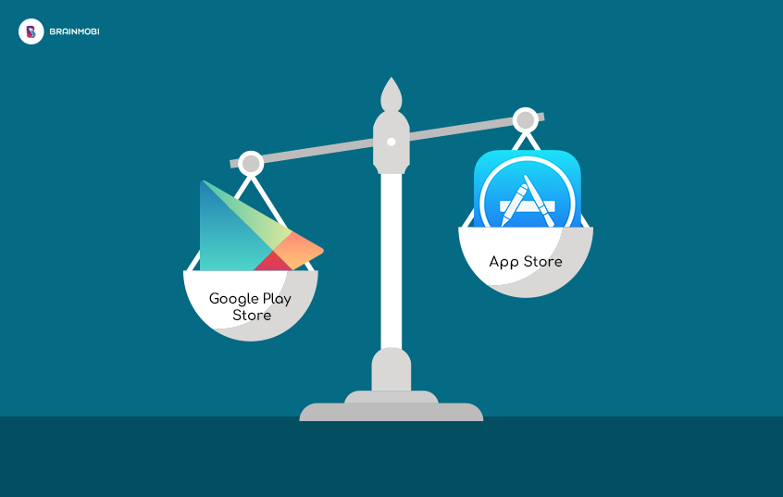

Slide 13
5. Cost and Accessibility:
iOS: iPhones are known for premium pricing, starting at Rs. 32,700. This exclusivity can limit accessibility to certain demographics.
Android: Android devices cover a wide price range, from budget phones under Rs. 10,000 to premium models. This affordability contributes to Android's global dominance.
6. Cross-Platform Compatibility:
iOS: Apple promotes cross-device compatibility with features like AirDrop, allowing easy sharing between iOS and macOS devices.
Android: Android's versatility extends to compatibility with various operating systems, making it more adaptable for users with diverse tech ecosystems.
7. User Experience and Interface:
iOS: Apple's minimalist design philosophy results in a user-friendly interface, but it may feel restrictive to those seeking more customization.
Android: Android's diverse user interfaces cater to different preferences. Samsung's One UI, for example, offers a feature-rich experience, while stock Android is clean and straightforward.

Slide 14
Objectives
1. Informed Decision-Making: Enable users to make informed choices between iOS and Android based on their preferences, needs, and priorities.
2. User Experience Analysis: Evaluate the user experience, customization options, and interface design of both operating systems to determine which aligns better with user preferences.
3. Ecosystem Understanding: Highlight the integration, compatibility, and ecosystem benefits of each OS, aiding users in selecting the one that suits their existing device lineup.
4. Security and Privacy Awareness: Educate users about the security and privacy features of iOS and Android, helping them choose an OS that aligns with their data protection
5. User Satisfaction and Loyalty: Explore user satisfaction levels, brand loyalty, and user retention to help users anticipate the long-term benefits of choosing iOS or Android.

Slide 15
Problem Statement
Comparative Analysis of iOS and Android Operating Systems: A Comprehensive Examination of User Experience, Ecosystem Integration, Security, Customization, Development Considerations and Market Share.

Slide 16
Proposed System
1. Ecosystem Preference:
Choose iOS for seamless integration with other Apple devices.
Choose Android for compatibility with diverse brands and ecosystems.
2. Customization vs. Simplicity:
Choose iOS for a polished and consistent user experience.
Choose Android for extensive customization options and diverse UI choices.

Slide 17
3. Security and Privacy:
Choose iOS for robust security features and stringent privacy controls.
Choose Android for a balance between security measures and openness.
4.App Diversity and Store Policies:
Choose iOS for a curated app store with high-quality apps and user-friendly policies.
Choose Android for a wide app selection and more lenient app approval process.
5. Development Focus and Challenges:
Choose iOS for streamlined development and early access to the latest features.
Choose Android for flexibility and a broader user base, despite potential fragmentation challenges.

Slide 18
6. Upgrade Frequency and Longevity:
Choose iOS for timely updates and extended support for older devices.
Choose Android for a range of devices at different price points, considering device longevity.
7. Budget and Affordability:
Choose iOS if willing to invest in premium-priced devices.
Choose Android for a wider range of budget-friendly options.
8. Cross-Platform Integration:
Choose iOS for seamless integration within the Apple ecosystem.
Choose Android for compatibility across various platforms and devices.

Slide 19
Future Scope
1. Foldable and Flexible Displays
2. 5G Integration
3. AI and Machine Learning
4. Privacy and Data Protection
5. App Ecosystem
6. Cross-Platform Integration
7. Sustainability and Environmental Initiatives
8. Emerging Markets
9. User Experience Innovations
10. Security and Biometrics

Slide 20
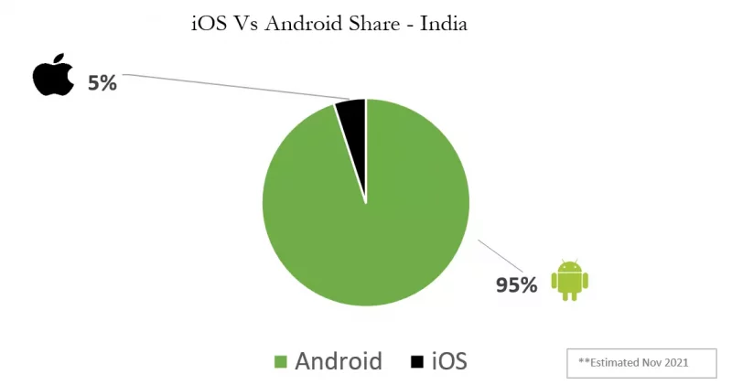
Mathematical Model
Market Share Analysis :

Slide 21
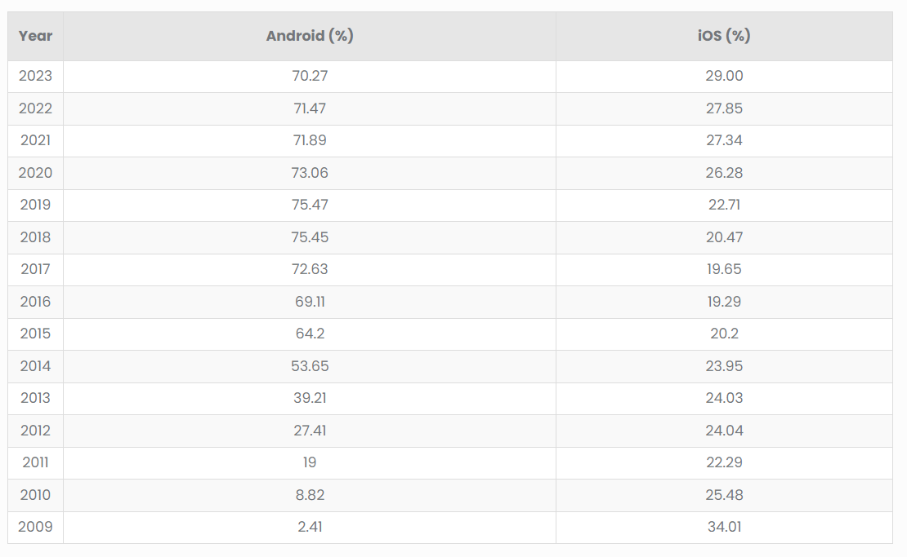
Source : bankmycell.com

Slide 22
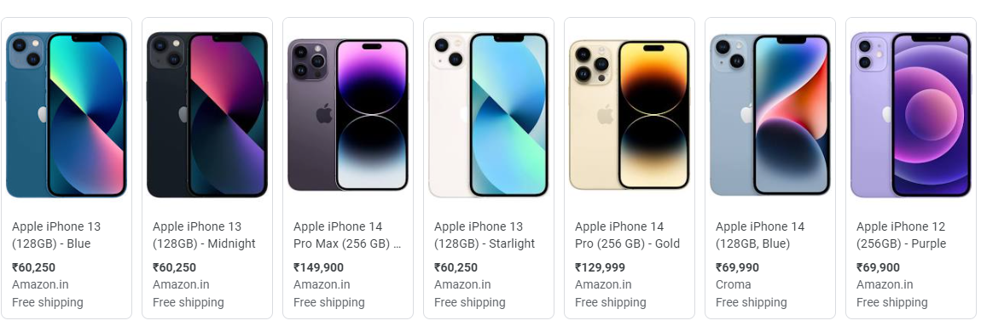
Price Comparison
iPhone Prices

Slide 23
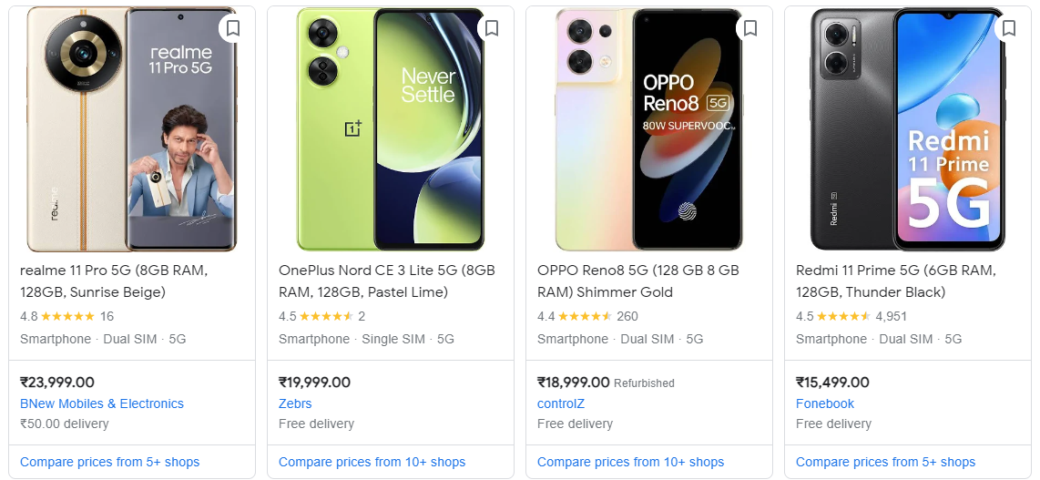
Android Phone Prices

Slide 24
Conclusion
In conclusion, the comparison between Android and iOS has highlighted several key differences that are important for consumers and businesses alike.
1. Market Share
2. Prices
3. Evolution
4. Security
5. Economic Parameters
Ultimately, the choice between Android and iOS depends on individual preferences and needs. Businesses should consider their target audience, budget, security requirements, and economic objectives when deciding which platform to prioritize.

Slide 25
References
A Comparative study of Android and iPhone Operating System main languages (Mohanad Ali Meteab Al-Obaidi, Yasmin Makki Mohialden, Muna Abdul Hussain Radhi, and Noor abdallah othman)
Security Comparison between Android and iOS (Aman Arora, Harsh Sharma, Puneet Aggarwal)
Comparative Analysis of Smartphone Operating system Android Apple iOS and Windows (Ankit Tiwari)
Research on the brand image of iOS and Android smart phone operating systems based on mixed methods (Weifeng Hu, Tianyun Hao, Yue Hu, Hui Chen, Yi Zhou and Wantong Yin)

Slide 26
THANK YOU!

